Slide 1
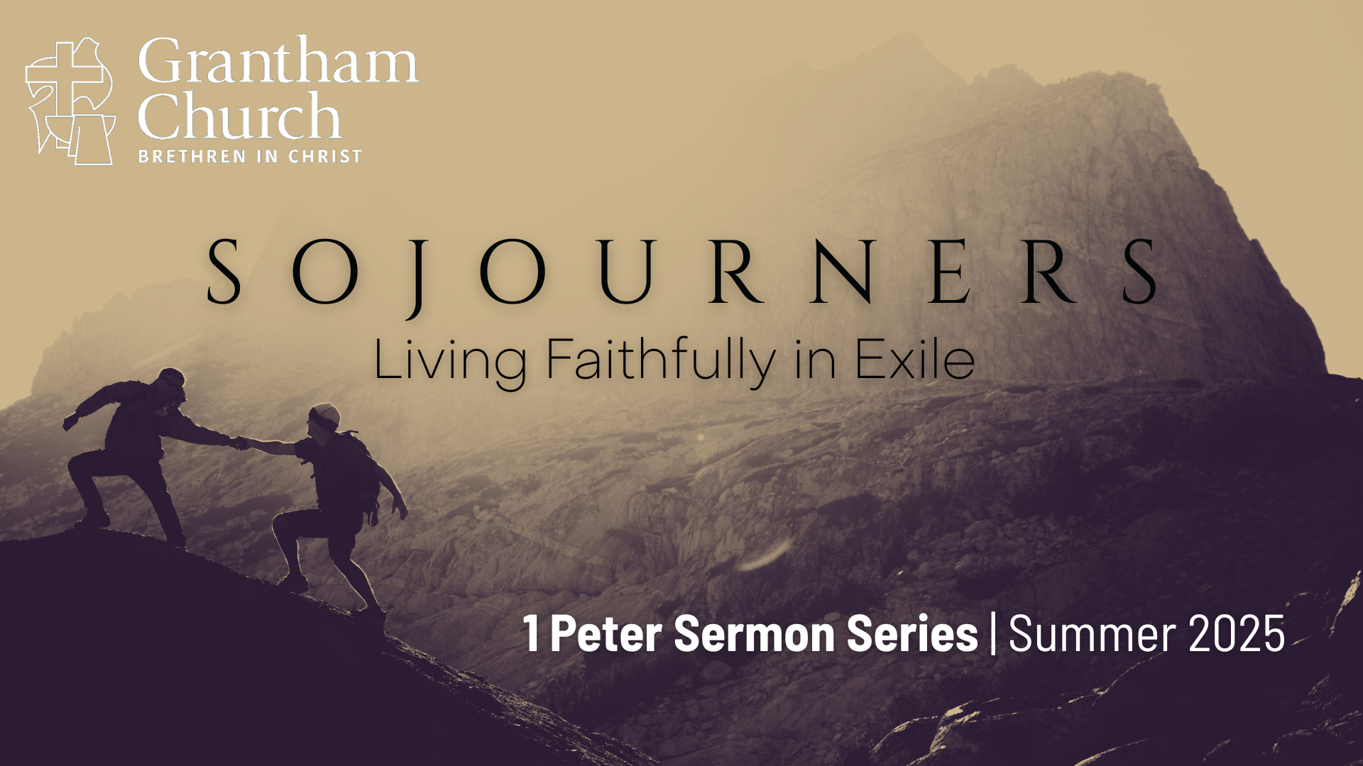
Notes:
This morning, we are continuing our summer sermon series in 1 Peter -- Sojourners: Living Faithfully in Exile.
It’s a common refrain in Peter’s first epistle, as well as the rest of the New Testament: as followers of Jesus, we are resident aliens, strangers, foreigners, sojourners, even “exiles” in the present evil age.
And you can hear this clearly in 1 Peter chapter 2, verses 11-12… [NEXT SLIDE]

Slide 2
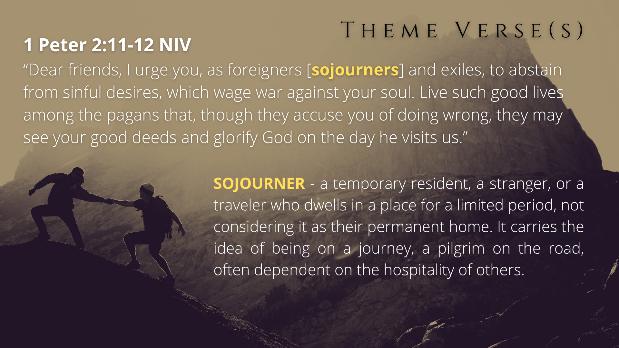
Notes:
[READ VERSES & DEFINITION]
In a world that often feels like it’s not our home, how do we live with courage, integrity, and purpose as disciples of Jesus? In this letter we call 1 Peter, the Apostle Simon Peter writes to early Christians in the first century who are living throughout Asia Minor as “sojourners and exiles,” offering timeless wisdom for navigating hardship, cultural pressure, and spiritual struggle. And so, we’re exploring what it means to be God’s chosen people—set apart for his plan and purposes in the world—as we learn how to embrace our identity in Christ, endure suffering with an ever-abiding faith, and live as hopeful witnesses of Jesus in a hostile world.
Peter began his letter by reminding these believers that their identity is in Christ, who has given us new birth into a living hope through the resurrection of Jesus Christ from the dead. It’s because of this belief in Christ and God’s good future that we can follow Jesus and live faithfully in exile. And then last week we heard Peter invite us to walk the way of the holy sojourner. We are to be holy as God is holy. We’re to be set apart for God’s purposes in the world, as we love one another deeply from the heart.
And that brings us to today’s message… [NEXT SLIDE]

Slide 3

Notes:
The third sermon in the Sojourners series, a message entitled, The Holy Chosen. This morning, we will be going verse-by-verse through 1 Peter chapter 2; the first 10 verses.
But before we do that, let’s pray and prepare our hearts to receive a word from the Lord.
[BRIEF PRAYER]
1 Peter chapter 2, beginning with verse 1… [NEXT SLIDE]

Slide 4

Notes:
You will notice as we begin chapter 2 that Peter is finishing his thought and wrapping up what he was saying in chapter 1, verses 22-25. He said, “Now that you have purified yourselves by obeying the truth so that you have sincere love for each other, love one another deeply, from the heart. For you have been born again, not of perishable seed, but of imperishable, through the living and enduring word of God. For, “All people are like grass, and all their glory is like the flowers of the field; the grass withers and the flowers fall, but the word of the Lord endures forever.” And this is the word that was preached to you.”
[READ VERSES 1-3]
v. 1 – “rid yourselves” or “take off” (like clothes) the old behavior, since you have been born again in Christ; you have a new identity that has been and is being shaped by the enduring word of God – the gospel message, the Scriptures, Jesus himself; the vices mentioned are likely a result of the pressure, the fear and uncertainty, and the troubles of the world around them; “malice” – ill will toward others, frequently joined with grumbling and bitterness; “deceit” – speaking or acting insincerely; “hypocrisy” – acting or playing a part; “envy” – resenting others; often works itself out as “slander” or criticism, possibly misrepresenting or lying about a person who you dislike, or you think is suspicious, or who has hurt you.
v. 2 – Again, since you have been born again, Peter says they are like ”newborn babies” – they are young in their Christian faith, and like newborns they ought to “crave pure spiritual milk” – they need the basic vitamins and nutrients of an infant. And what might that look like for young Christians? It’s safe to say that Peter certainly has in mind that these believers should meditate on the gospel and on the way of Jesus through a variety of avenues (e.g., worship, Scripture, prayer, etc.). More character formation through discipleship!
v. 3 – they have already tasted, so continue to go to Jesus for more of his life.
The milk metaphor is one that Paul used as well. Listen to what he wrote to the believers in the church of Corinth… [NEXT SLIDE]

Slide 5
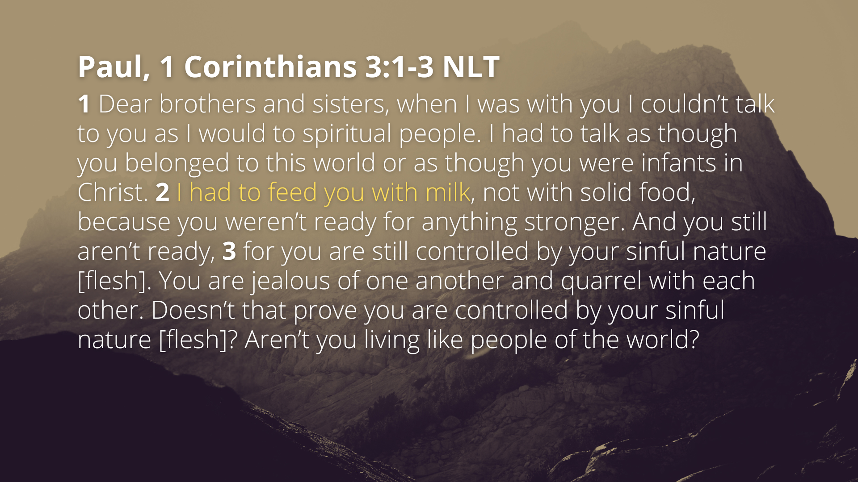
Notes:
[READ PASSAGE & COMMENT]
Paul is saying, if you’re still acting spiritually immature (like infants or children who haven’t learned how to regulate their emotions, show restraint, and love others deeply), then is it any wonder why you have so many problems within your community?
Does this not accurately reflect the spiritual state of a great deal of Christianity in America? Why do so many Christians and churches not look like Christ? It’s because they are not growing up in him! It’s because many professing Christians are still on breast milk or infant formula. And for some, what they’re drinking isn’t the milk of Christ at all but rather (as Revelation says) the maddening wine of imperialism, creature comforts, and idolatry. And as Jesus said, by their fruit you will know who is who (Matt.7:16)!
Back to 1 Peter, chapter 2, verse 4… [NEXT SLIDE]

Slide 6
Notes:
[READ VERSES 4-5]
v. 4 – Peter uses an OT metaphor: a foundational stone in the Temple; Jesus is the Living Stone, upon which God is building a new Temple-–a building made of souls. Notice that this Living Stone was rejected, but he was “chosen” by God and that’s all that matters.
v. 5 – Christ is the foundation on which disciples, like ”living stones” are being used to build a “spiritual house” where God’s Spirit dwells, is worshipped, and works through in the world; and not just a “spiritual house” but also a ”holy priesthood” set apart to bring people to God and to offer., not animal sacrifices, but, spiritual sacrifices, involving praise and thanksgiving, prayer and communion, but also loving service to one another.
Now, let’s pause with our reading of 1 Peter for a few minutes and reflect on the “chosen” language that Peter is using in verse 4 (and as we will see again in verse 9), by going back to its usage in the Old Testament… [NEXT SLIDE]

Slide 7
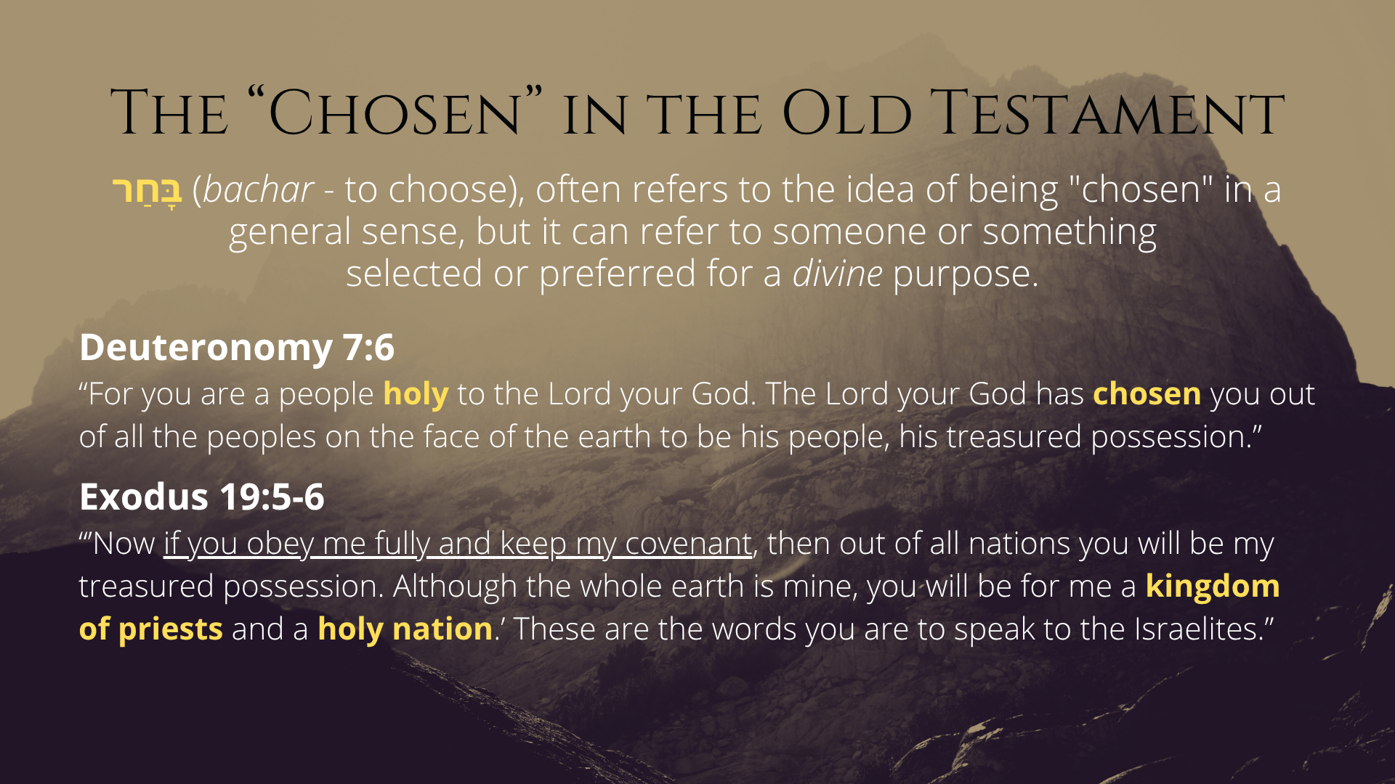
Notes:
[READ SLIDE & COMMENT]
Read definition
Deut. 7:6 – “holy” – set apart, morally pure, righteous, whole, full of light and love like God; ”Be holy as I am holy” – the reason for all the purity laws and being ceremonially clean was to teach God’s people a hard lesson about how Yahweh is far above sinful humanity. And yet, Israel was called to be a holy people. They were chosen for this purpose.
Exod. 19:5-6 – God had Moses communicate this to Israel while in the wilderness. After generations, it was clear that Israel could not keep God’s covenant. But God’s desire for his people and the calling remained. So, what does God do? He sends Jesus.
Peter told us back in 1 Peter 1:20, that, “He [Jesus] was chosen before the creation of the world, but was revealed in these last times for your sake.” So, let’s consider now what the New Testament says about Christ and the changes he makes related to God’s covenant and the calling he has for his “chosen people… [NEXT SLIDE]

Slide 8
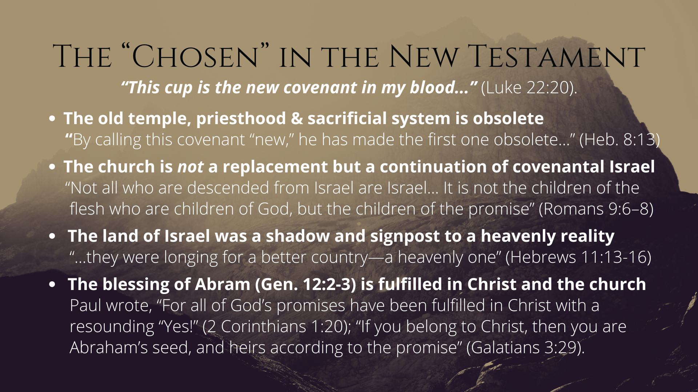
Notes:
[READ SLIDE & COMMENT]
And so, don’t miss this… Jesus—the chosen One of God—is the true and faithful Israelite. He embodies holiness and does what Israel could not do. And this Jesus, in his life and ministry, is not made unclean by being with sinners or touching the unclean; instead, he makes them clean by healing them, forgiving them, and calling them to follow him. [NEXT SLIDE]

Slide 9
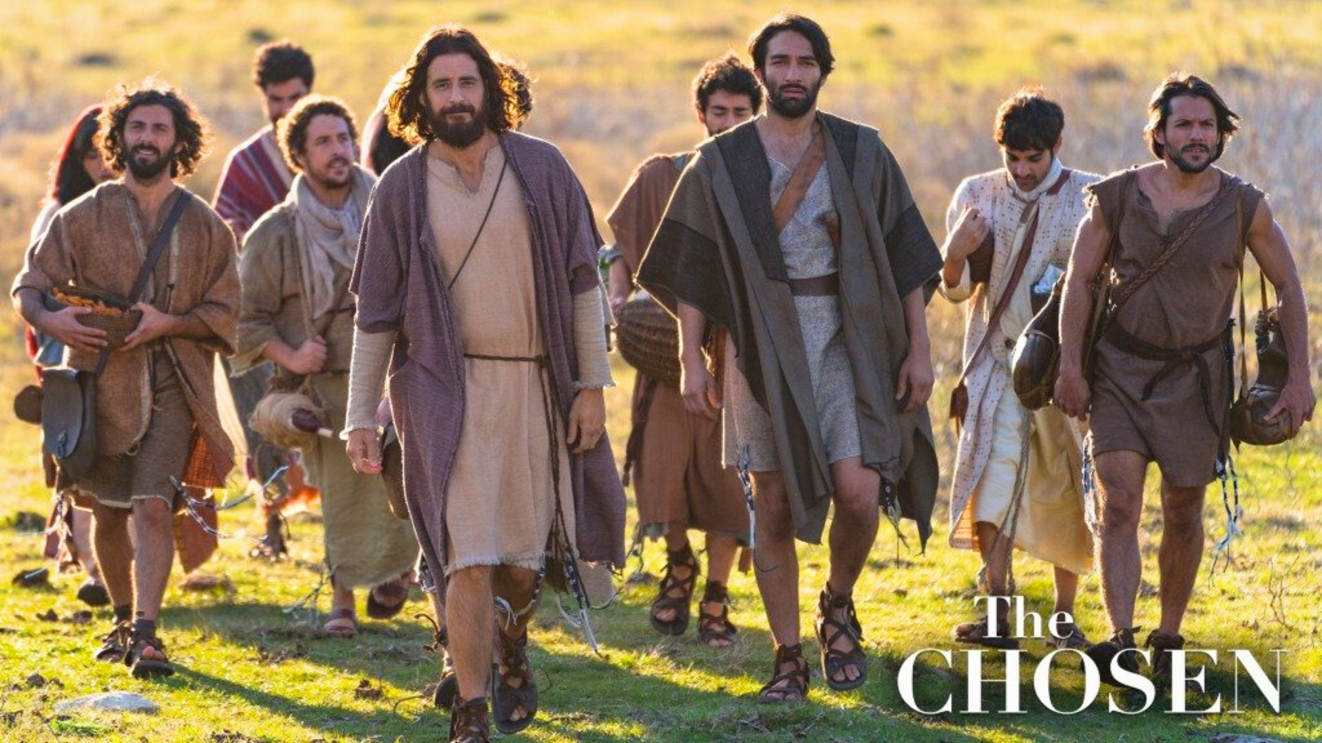
Notes:
And this is what Jesus is doing when he chooses disciples. As you see in this image from the popular streaming show, The Chosen. We need to understand that when Jesus chooses his disciples, he is reconstituting Israel, the people of God; a holy nation, a royal priesthood, and building his church upon himself—the Living Stone. And he established a new covenant, where all the promises of God are fulfilled in him and are put on display through his church.
Now, you might think that this “good news” of God’s love, mercy, and forgiveness—his grace and truth through Jesus Christ—would be welcomed by all people. And it’s certainly received as good news by many folks. But for others… those who love this world, those who live for themselves and according to the flesh, those who prefer to live like there is no God or divine justice, and those who do not wish to repent of their sins… Jesus said you can expect that they will not welcome you. Instead, they will hate you. That’s why Jesus said… [NEXT SLIDE]

Slide 10
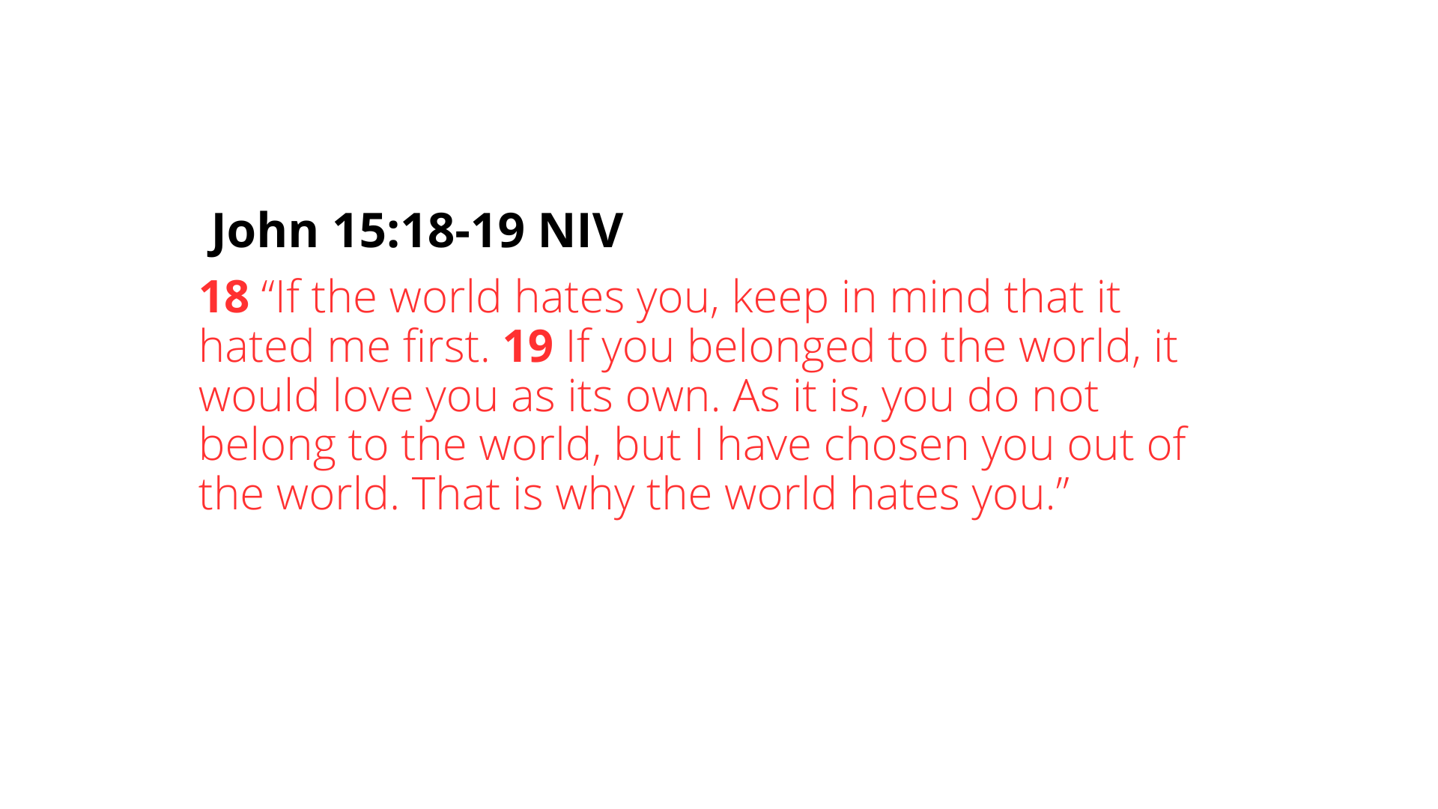
Notes:
[READ PASSAGE & COMMENT]
A sobering reminder that even when we choose to live like Jesus, we may still be disliked or hated by the world; sojourners living in exile should not be surprised by this.
Now, back to 1 Peter, chapter 2, verse 6… [NEXT SLIDE]

Slide 11
Notes:
[READ VERSES 6-8]
Verse 8 – “what they were destined for” – NT scholar Peter Davids says that Peter is “referring more to corporate destiny than to individual destiny, to the irony that a group formerly estranged from God (the Gentiles) is now [chosen] or “in,” while a group that would seem to have as good or better chance of being “in” is now “out” (NICNT, pg. 90).
In other words, when Jesus (God in the flesh) comes and lives a holy life in total submission to the Father (revealing his perfect will for human beings), it is no surprise (even certain or “destined”) that there will be people in this fallen world who will reject what Jesus stands for, what he freely offers to us, and his invitation to be his holy chosen.
Lastly, verses 9 and 10… [NEXT SLIDE]

Slide 12
Notes:
[READ VERSES 9-10]
v. 9 – Again, all of these descriptors of old Israel are now being applied to the church; “chosen people” – set apart to be like Christ and live for God; “royal priesthood” – to be ministers wherever God has placed us in this world; and to be a “holy nation” – not a nation-state, but a multi-ethnic, diverse, radical Kingdom community of Christ-followers—children of the light who reflect the love of God to our neighbors, even while in exile.
v. 10 – Peter quotes a poem from the prophet Hosea to remind these suffering Christians, just as Abram was once adopted by God to begin his redemptive story through Israel, now they too have been adopted and brought into the new Israel through Christ our Lord.
Therefore, God has called us into his wonderful light so that we might be holy as God is holy; that we would be about his work of bringing hope and healing to others; so that others can come to know him through us. So that those that the world sees as ”unclean” or beyond saving or those dubbed our “enemies” would know the mercy, grace, and forgiveness of God. This is our calling and our purpose as the holy chosen. This is how we shine God’s light. Listen to what Jesus said… [NEXT SLIDE]

Slide 13
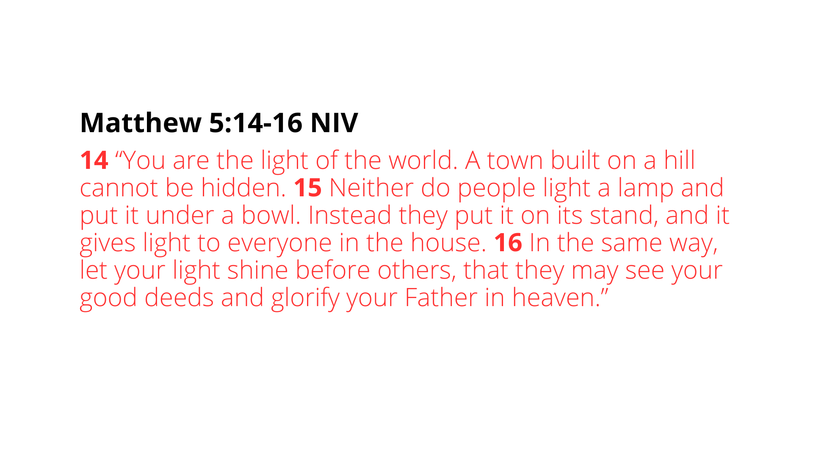
Notes:
[READ PASSAGE & COMMENT]
Remember that Jesus said this after he gave us the beatitudes, calling us to embody the good news. This is how the Lord is inviting us to let our light shine… [NEXT SLIDE]

Slide 14
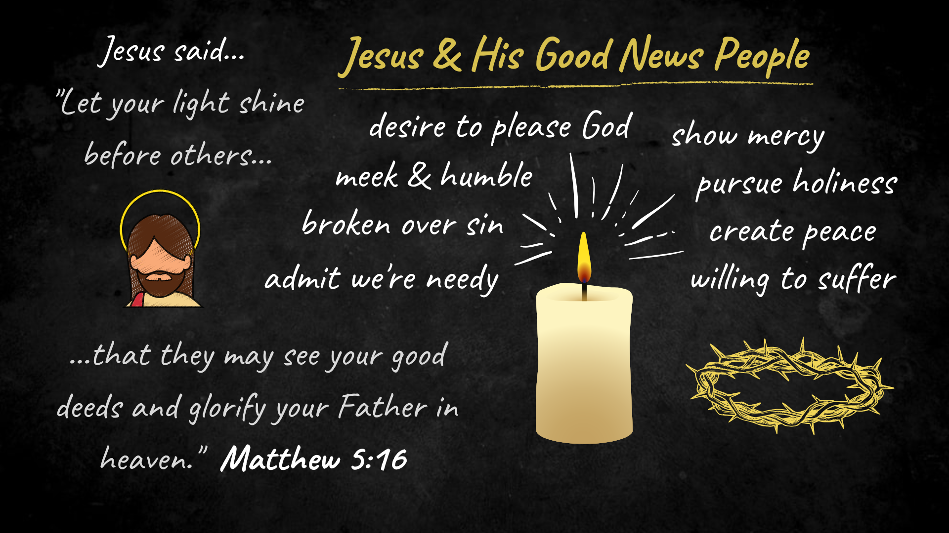
Notes:
Letting our light shine before others looks like…
Admitting that we are spiritually poor and in need of Jesus
Being broken over our own sin, at least as much as the sins of the world
Being meek and humble, not arrogant, prideful, and hard-hearted
Showing that we desire to please God, not to please people
Being merciful in our speech and actions
Pursuing holiness and purity of thought and life
Being peacemakers by helping to create peace in the world
And being willing to suffer for living faithfully in exile
To sum up what we’ve heard in this message, and to help us with applying it to our lives, here are some takeaways for us to consider… [NEXT SLIDE]

Slide 15
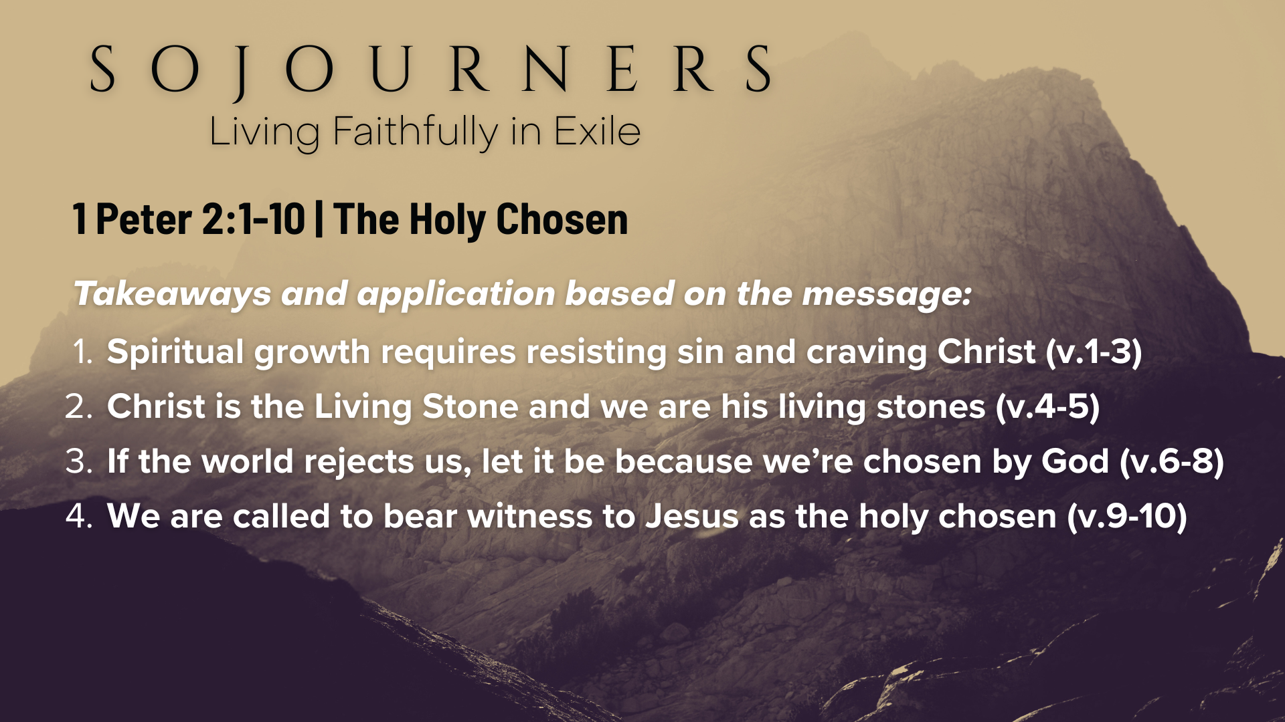
Notes:
Spiritual growth requires resisting sin and craving Christ (v.1-3) We must regularly examine our hearts and allow God to remove attitudes and behaviors that don’t reflect Jesus and are detrimental to relationships. This happens more easily when we are cultivating a relationship with Jesus through spiritual disciplines.
Christ is the Living Stone and we are his living stones (v.4-5) Our faith is built on the person of Jesus, as well as our church. And to be “living stones” means that we must be actively participating in the church and a life of worship and service; and most importantly, being shaped and fashioned together in relationships.
If the world rejects us, let it be because we’re chosen by God (v.6-8) As the holy chosen, any rejection from the world ought only to be a result of us living like Christ, not from being hypocritical, legalistic, self-righteous jerks. But we should also not be surprised when the world rejects us for following Jesus, doesn’t want to include us in what they’re doing, or doesn’t want to hire us, or hang out with us.
We are called to bear witness to Jesus as the holy chosen (v.9-10) Therefore, we must live out our distinct calling—living and declaring the greatness of the One who has called us out of darkness into light. And we can bear witness to who Christ is and who we are by embodying his life and teachings; letting Jesus live through us.
Finally, here are some questions to help us reflect on what we’ve heard and respond to how the Spirit is leading us this morning… [NEXT SLIDE]

Slide 16
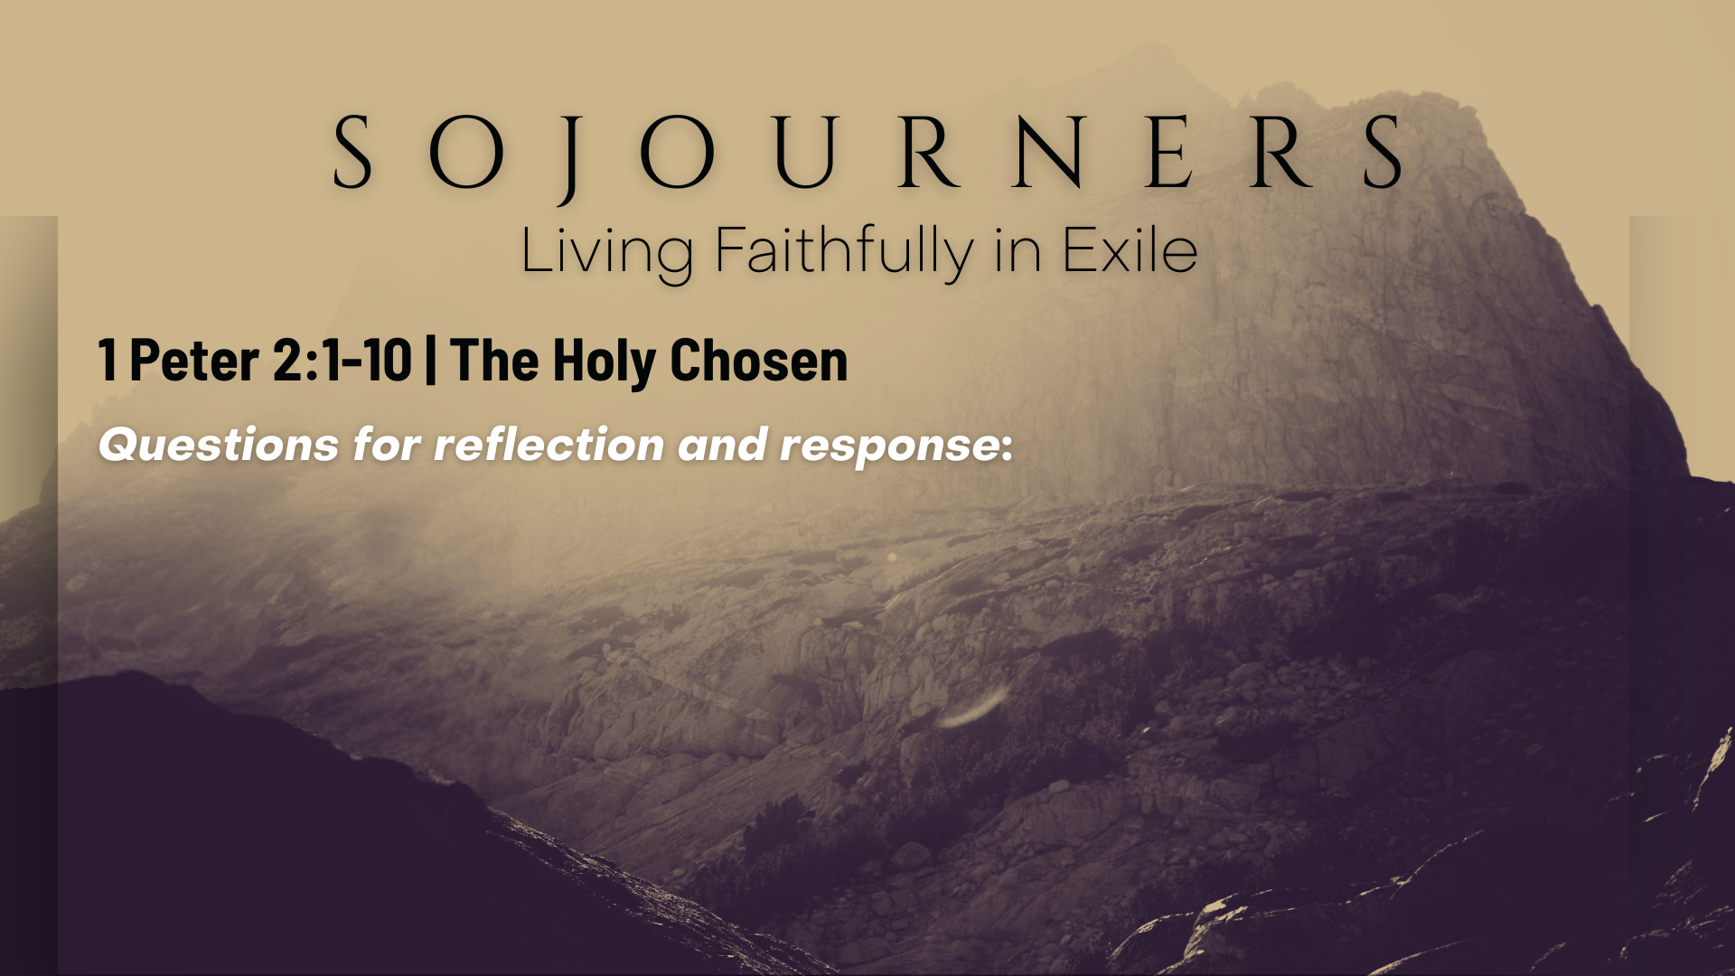

Slide 17
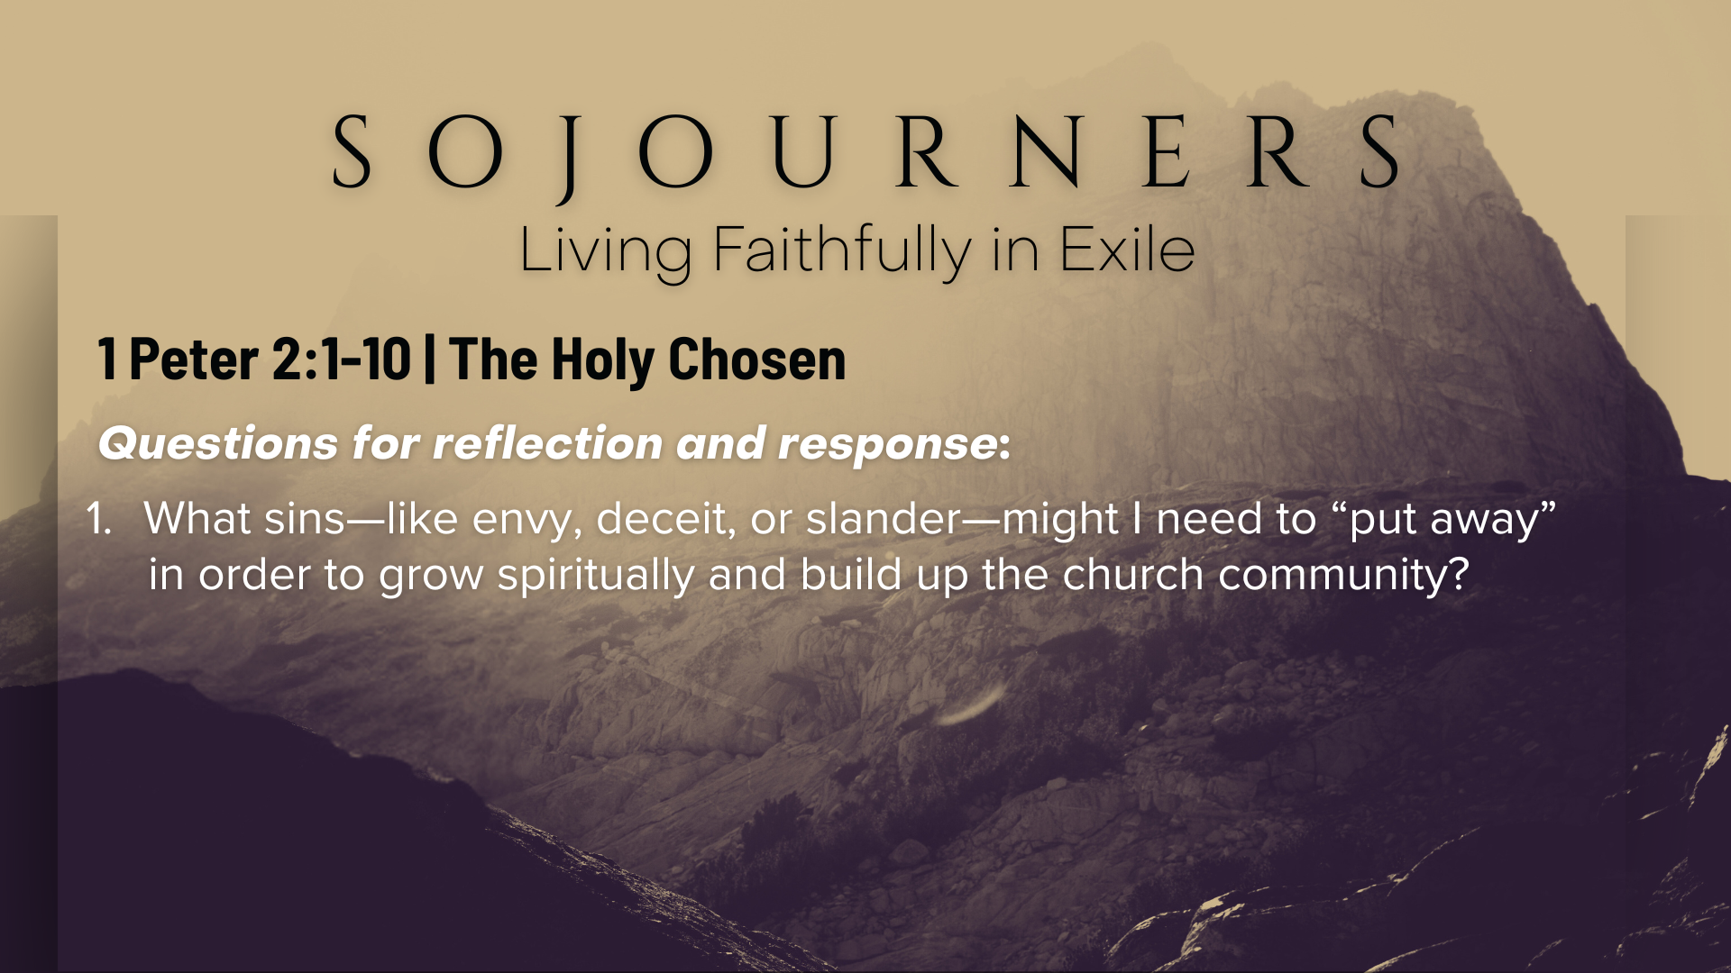

Slide 18
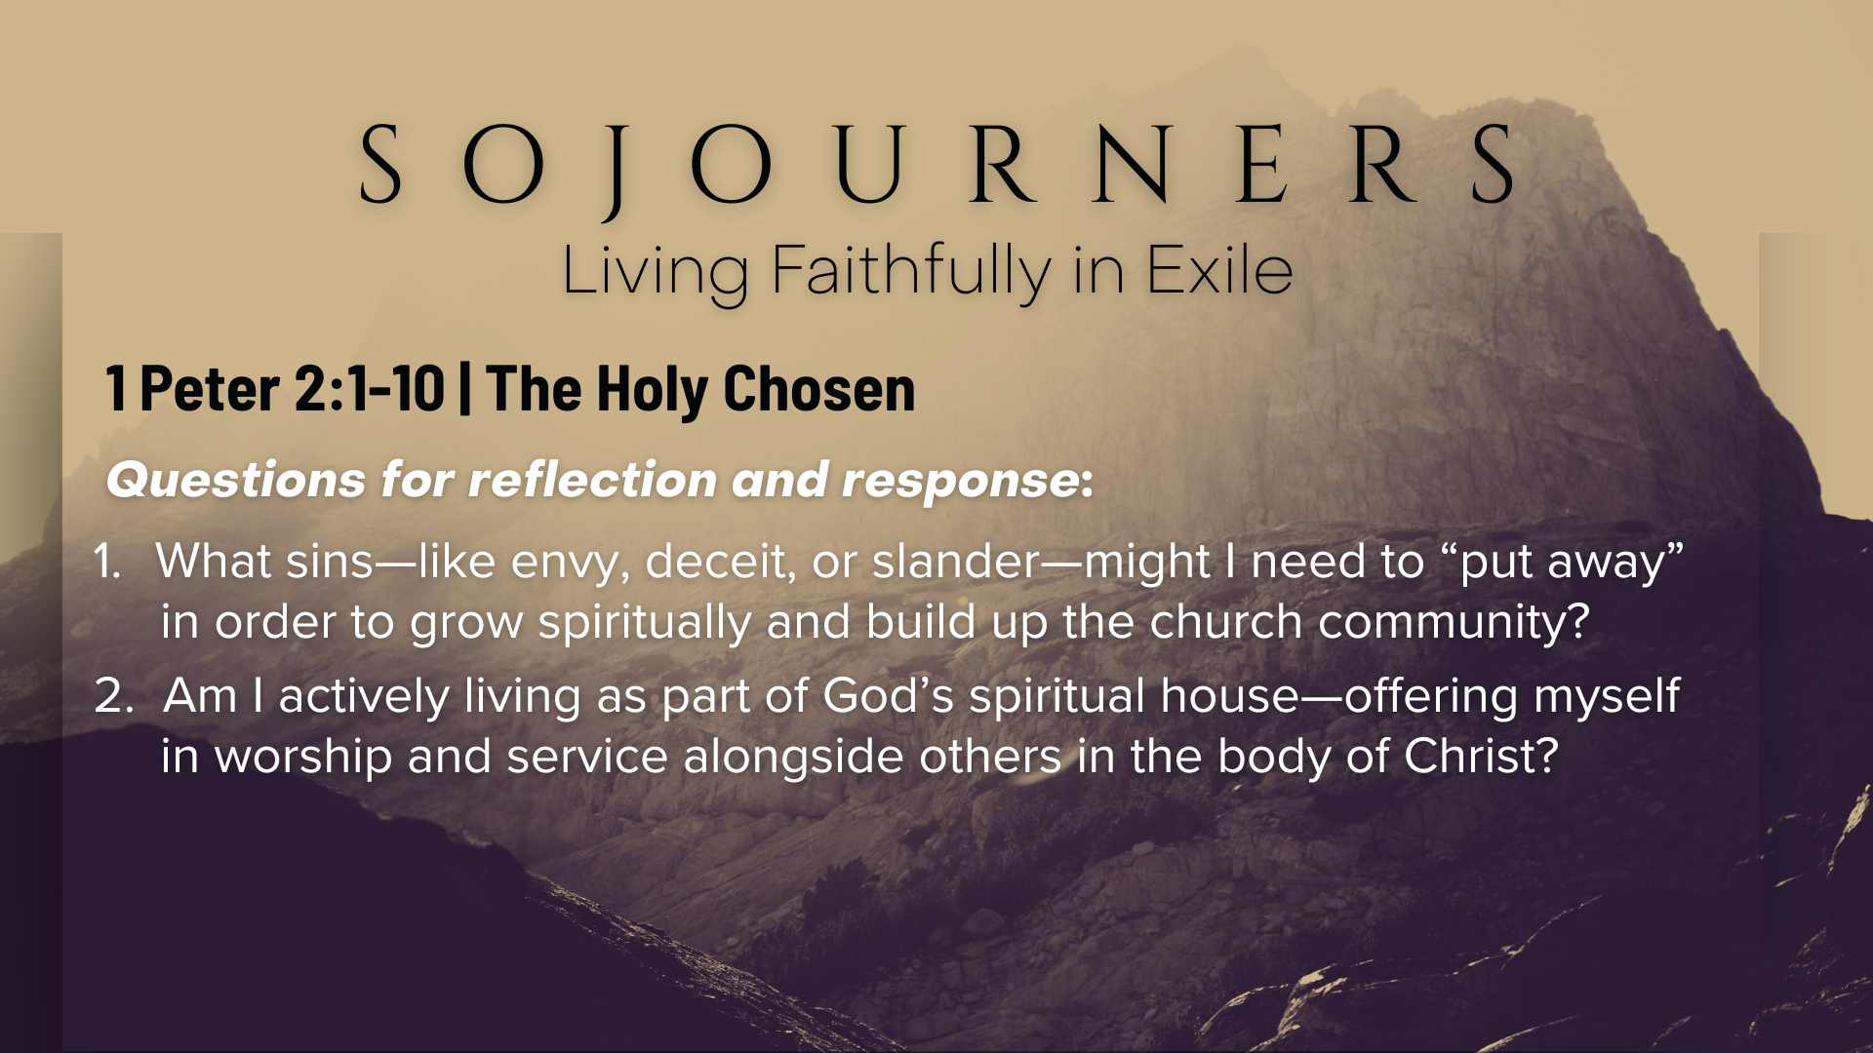

Slide 19
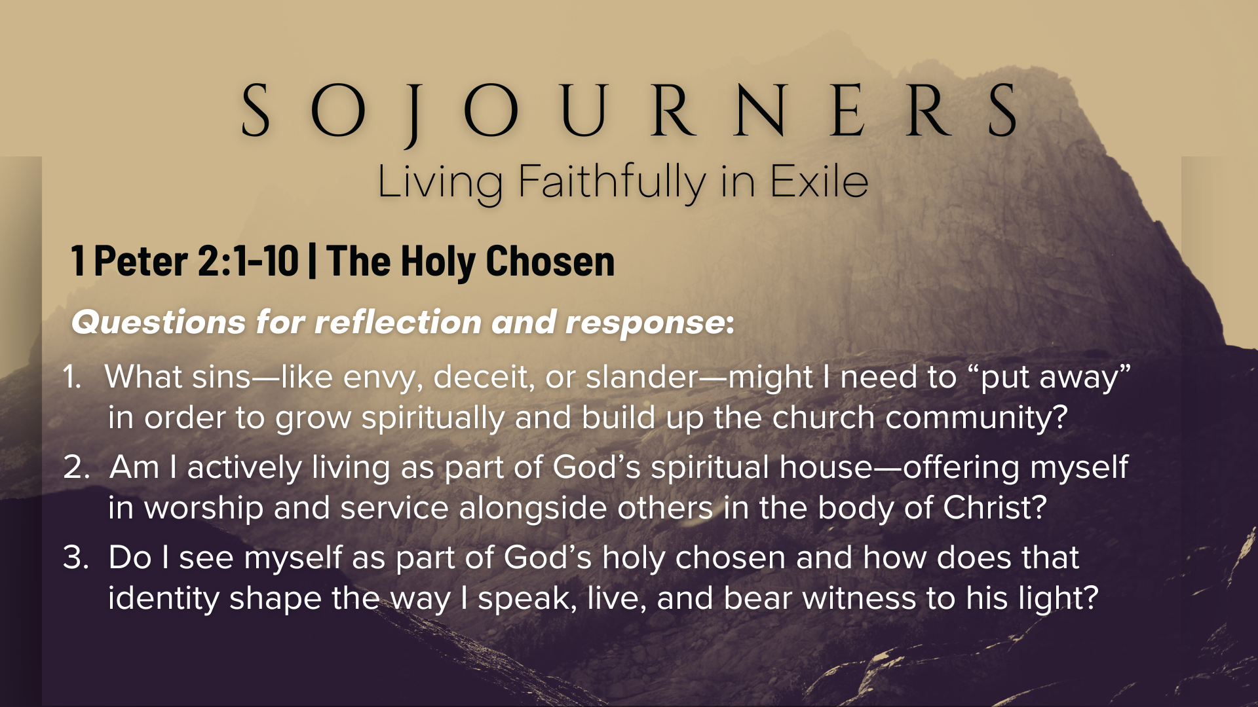
Notes:
[READ & BRIEF COMMENT ON EACH QUESTION]
What sins—like envy, deceit, or slander—might I need to “put away” in order to grow spiritually and build up the church community?
Am I actively living as part of God’s spiritual house—offering myself in worship and service alongside others in the body of Christ?
Do I see myself as part of God’s holy chosen and how does that identity shape the way I speak, live, and bear witness to his light?
[CLOSING WORDS]
Let’s pray… [NEXT SLIDE FOR CLOSING PRAYER]

Slide 20
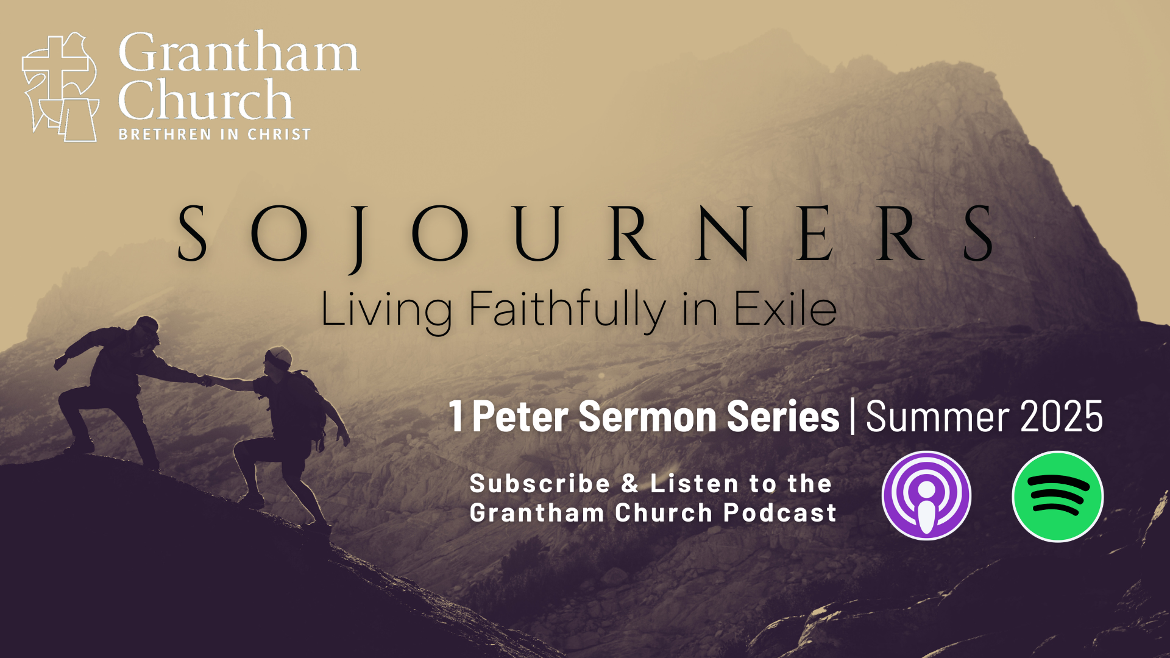
Notes:
[CLOSING PRAYER]
Benediction
Chosen people of God, as sojourners and exiles in this world,
set your hearts on the Living Hope – Christ risen and reigning.
As you go into the world,
may you walk in hope,
stand firm in God’s grace,
shine with the love of Jesus,
and allow the Spirit to sustain you in all things,
until the day your sojourning gives way to glory.
Go in peace, church,
and live faithfully in exile.
Amen.

